Slide 1
Area of polygon(01.07.20, 03.07,20)
Grade 8 – Chapter 15

Slide 2
Polygon
A polygon is a closed shape that has at least three sides.
Triangles, quadrilaterals, rectangles and squares are all types of polygons.
Moreover, a polygon can be of any shape and can have any number of sides.
There is no specific formula for calculating the area of a polygon.
The best way is to split the polygon into shapes whose area can be calculated individually.

Slide 3
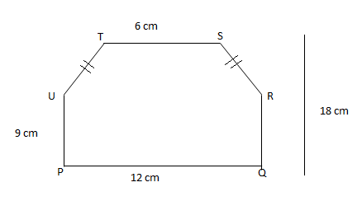
Example 1 Find the area of the given polygon PQRSTU

Slide 4
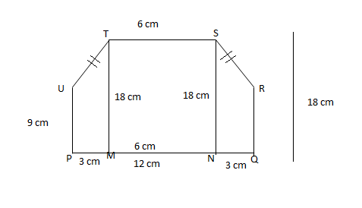
Solution
Area of the Polygon PQRSTU = Area of PMTU + Area of MNST + Area of NQRS

Slide 5
Area of PMTU(Trapezium)
a=9 cm, b= 18cm, h = 3 cm
Area of trapezium = ½ x h x (a+b) sq. units
= ½ x 3 x(18+9)
=81/2 sq. cm

Slide 6
Area of MNST(rectangle)
l= 18 cm, b= 9 cm
Area of rectangle = l x b sq. units
= 18 x 9
= 108 sq cm

Slide 7
Area of NQRS(Trapezium)
Area of NQRS = Area of PMTU
= 81/2 sq. cm

Slide 8
Area of the Polygon PQRSTU = Area of PMTU + Area of MNST + Area of NQRS
= 81/2 +108 + 81/2
= 162/2 + 108
= 81 + 108
= 189 sq.cm

Slide 9
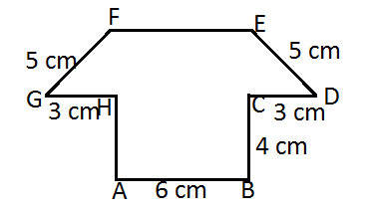
Example 2
Find the area of the polygon ABCDEFGH

Slide 10
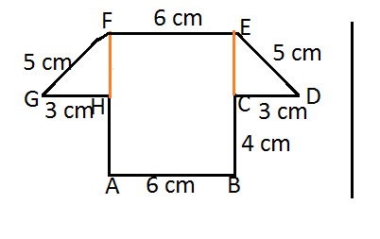
Area of the Polygon ABCDEFGH = Area of ABEF + Area of ECD + Area of FGH

Slide 11
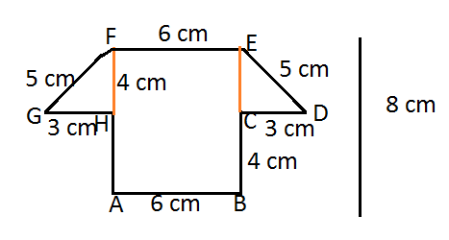
GHF is a right triangle
HF²+ GH²= GF² (Pythagoras theorem)
HF²= GF²- GH²
= 5²- 3²
= 25 – 9
= 16
HF = 4 cm

Slide 12
Area of ABEF(rectangle)
l= 8 cm, b= 6 cm
Area of rectangle = l x b sq. units
= 8 x 6
= 48 sq cm

Slide 13
Area of GHF (triangle)
b = 3 cm, h = 4 cm
Area of GHF = ½ x b x h sq units
= ½ x 3 x 4
= 6 sq cm

Slide 14
Area of DCE (triangle)
b = 3 cm, h = 4 cm
Area of DCE = ½ x b x h sq units
= ½ x 3 x 4
= 6 sq cm

Slide 15
Area of the Polygon ABCDEFGH = Area of ABEF + Area of ECD + Area of FGH
= 48 sq.cm + 6 sq.cm + 6 sq.cm
= 60 sq cm

Slide 16
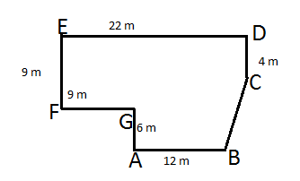
Exercise 15.2
1. Find the area of each of the polygon

Slide 17
